Slide 1
Optimal Neighborhood to Open a Restaurant in Toronto
IBM Data Science Professional Certificate Capstone Project
Ahmed Hourani

Slide 2
Introduction
Scenario: We want to open a restaurant that serves Arabic food in Toronto.
One of the most important factors when opening a restaurant is the location.
How can data science be used to help make the best decision.

Slide 3
Data
We will use the following information:
List of neighborhoods in Toronto (Toronto Census)
Population in each neighborhood (Toronto Census)
Number of Arabic speaking people in each neighborhood (Toronto Census)
Average income in each neighborhood (Toronto Census)
Number of restaurants in each neighborhood (Foursquare API)
Number of Arabic restaurants in each neighborhood (Foursquare API)

Slide 4
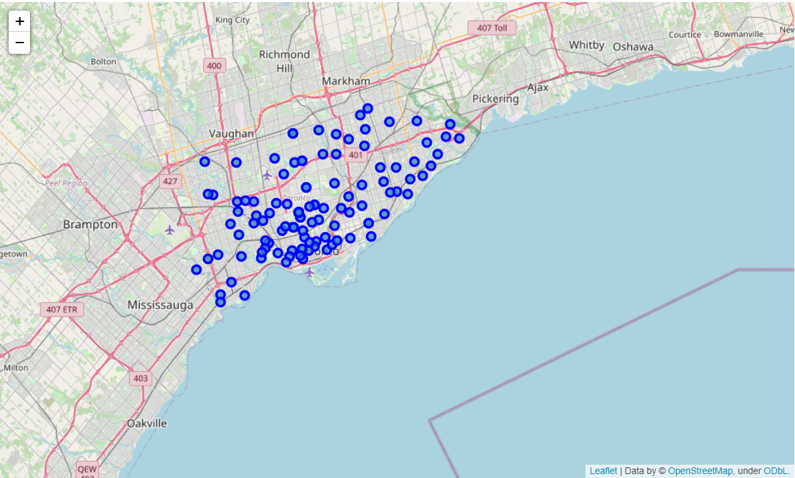
Map Of All The Neighborhoods

Slide 5
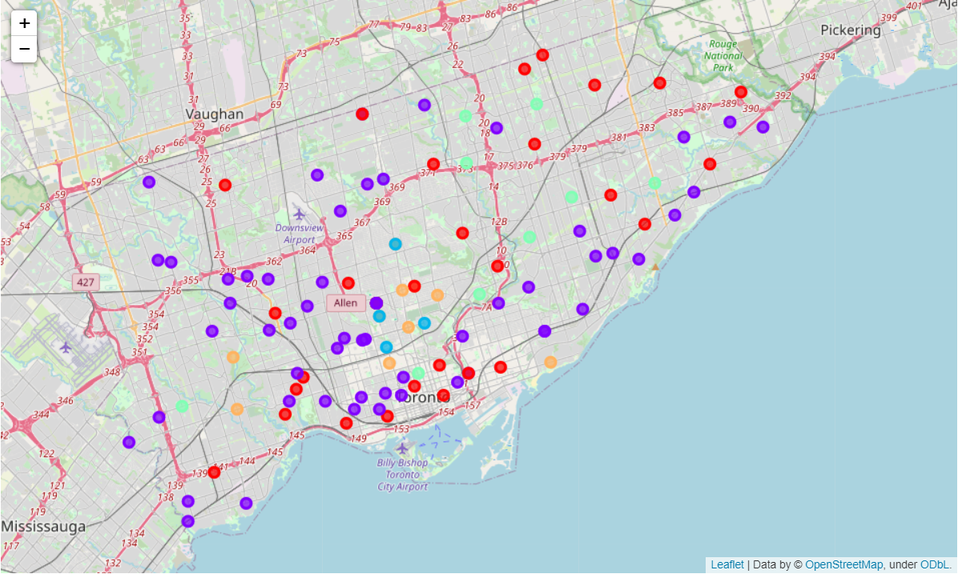
Clustered Neighborhoods Using K-means

Slide 6
Characteristics of Each Cluster
Using the describe function, we can observe the following characteristics in each cluster
Cluster | Population | Arabic Speaking Population | Average Income (,000$)
0 | High | 244 | 42
1 | Low | 88 | 45
2 | Low | 71 | 210
3 | High | 911 | 40
4 | Low | 81 | 106

Slide 7
Back To Business Understanding
There is no clear cluster to choose. For this reason, we need to dig into the business understanding part.
Question: How high class is the restaurant going to be in terms of pricing?
Answer: Medium class (not high)
This means we can choose cluster 3 even though it doesn’t have a very high average income

Slide 8
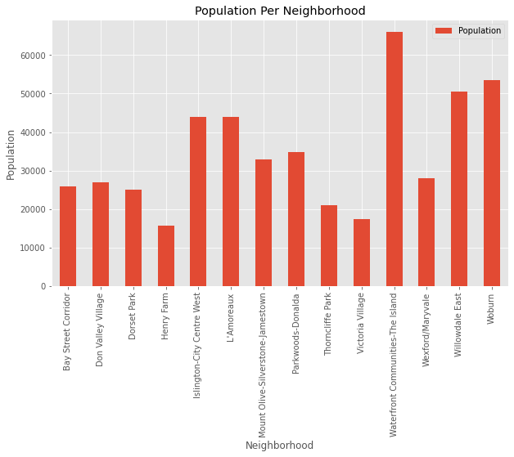
Bar Chart of Restaurants in Cluster 3: Population Per Neighborhood

Slide 9
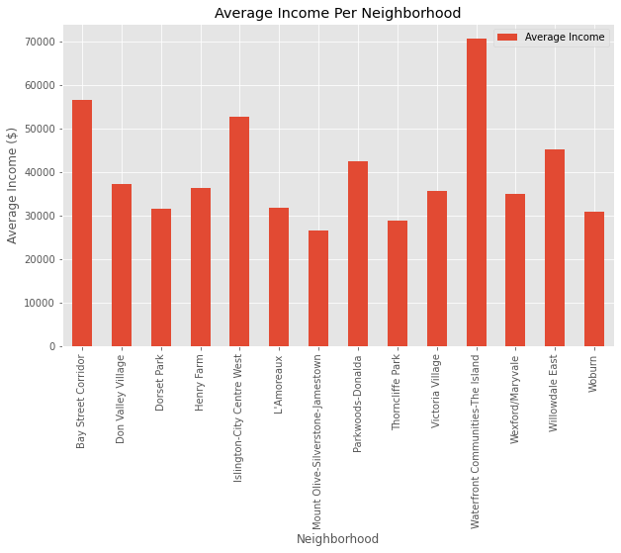
Bar Chart of Restaurants in Cluster 3: Average Income Per Neighborhood

Slide 10
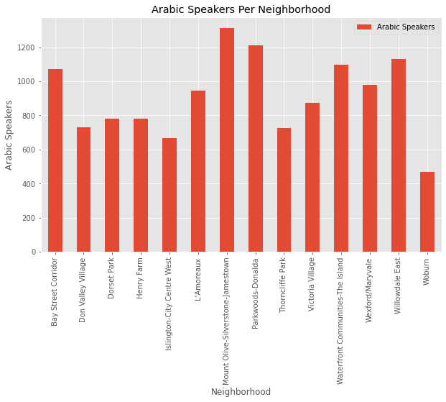
Bar Chart of Restaurants in Cluster 3: Arabic Speakers Per Neighborhood

Slide 11
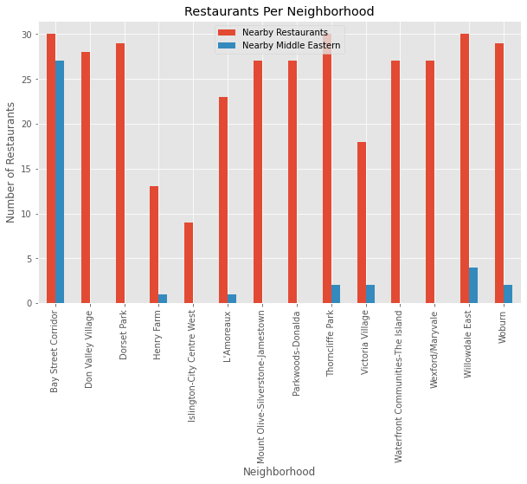
Bar Chart of Restaurants in Cluster 3: Restaurants per Neighborhood

Slide 12
Decision
Our last goal is to determine which of the cluster 3 neighborhoods is the optimal neighborhod to open our restaurant.
Waterfront Communtities-The Island: This is our top choice. This neighborhood has the highest average income, highest population, high population of Arabic speakers, and zero Middle Eastern restaurants
Mount Olive-Silverstone-Jamestown: This is our second choice. This neighborhood has the highest number of Arabic speakers, and no middle eastern restaurants. However this neighborhood has an average total population and a low average income as compared to other neighborhoods.

Slide 13
Conclusion
Data science is a great tool which can be used in many business situations to help us make the best decisions possible given the resources.
One must apply business understanding in order to ensure the best results.

